Slide 1
542: Leadership and the Parallel Process

Slide 2
Agenda
Welcome and Introductions
What Makes an Effective Leader?
Consequences of Ineffective Leadership
What Makes an Effective Child Welfare Worker?
Consequences of Ineffective Relationship with Clients

Slide 3
Agenda (Continued)
The Parallel Process
Theoretical Parallels
Learning Organizations
Tips for Promoting a Learning Organization
Summary and Evaluations

Slide 4
Learning Objectives
Participants will be able to:
Examine elements of the relationships between Leader/Employee and Employee/Client;
Identify behaviors that can diminish and enhance employees' morale and commitment; and
Discuss the role organizations play in this process.

Slide 5
Effective Leader: Characteristics
Trust
Honest
Respect
Strength-Focused

Slide 6
Consequences of Ineffective Leadership
Lack of trust, develops mistrust.
Little opportunity for growth and development (employee).
Lowered morale.
Employees do not feel treated respectfully.
Decreased productivity.
Despair in the workplace.

Slide 7
Effective Employees: Characteristics
Strength-based, relationship centered approach.
Emphasis on respect for client.
“A trusting relationship is essential…”
“Meet the client where they are.”

Slide 8
Consequences of Ineffective Relationship with Client
Contributes to cycle of despair;
Lack of trust - Lowered belief that situation can improve;
Client does not feel respected;
Decreased motivation; and
Lack of progress towards goals.

Slide 9
Keypoint
If our employees are treated poorly, what are the chances our clients will not receive the best of care?
If the workplace is “crisis filled,” how do employees provide essential skills to clients to help break their “crisis cycle?”

Slide 10
Parallel Process
“…there are parallels between the dynamics of supervision and any other helping relationship. Therefore, the skills that are important in direct practices with clients or patients are also important to the supervisory relationship.” (Shulman, 2010)
“It is …very clear that client issues cannot be resolved by helping systems that repeat the same problems” (Mehr, 1995).
Our systems frequently recapitulate the very experiences that have proven to be so toxic for the people we are supposed to treat. (Bloom, 2006).

Slide 11
More Parallels
Workplace
Broken feedback loops
Lack of conflict resolution skills
Failure to recognize exposure to trauma
Clients/staff – loss of history
Too loose/too rigid boundaries
Acting out, collective disturbance
Client
Poor communication skills
Poor relationships
Reluctance/inability to discuss
The traumatic past – loss of history
Poor boundaries
Poor self-control, self-discipline

Slide 12
Even More Parallels
The most important ingredients in building a therapeutic alliance include the client liking and trusting the therapist or therapeutic staff.
(Figley & Nelson, 1989)
When leaders create a climate of trust, they take away the controls and allow people to be free to innovate and contribute. Trusting leaders nurture openness, involvement, personal satisfaction, and high levels of commitment to excellence.
(Kouses & Posner, 2003)

Slide 13
Non-Strength-Based Thinking Worker
I Have Power Over You!
After All…I Am the Professional!
Let Me Tell You What's Wrong With You!
Let Me Choose What’s Best for You!
I Don’t Expect Much From You?
These Type Of People Are Bad!

Slide 14
Non-Strength-Based Thinking Leader
I Have Power Over You!
After All…I Am the Boss!
Let Me Tell You What's Wrong With You!
Let Me Choose What’s Best for You!
I Don’t Expect Much From You?
These Type Of Employees Are Bad!

Slide 15
Strength-Based Thinking Worker
Let’s Focus on Strengths.
We Share the Power of This Relationship.
People Have Different Knowledge.
We Choose What’s Best for You.
I Expect Much From You!
These People are Basically Good.

Slide 16
Strength-Based Thinking Leader
Let’s Focus on Strengths.
We Share Responsibility For This Relationship.
People Have Different Knowledge.
We Choose What’s Best For You.
I Expect Much From You! (Accountability)
My Employees Are Basically Good.

Slide 17
Stages of Change Model
PRECONTEMPLATION
Not seriously considering change
CONTEMPLATION
Thinking about change
PREPARATION
Getting ready to make change
ACTION
Making the change
MAINTENANCE (with
episodes of relapse)
Sustaining behavior change/
Integrated into lifestyle
Prochaska and DiClemente, 1994

Slide 18
Parallels?
Competency Development.
Commitment = Motivation + Confidence.
Ownership of Responsibility.
Relationship is Essential.
Trust is Critical.
Meet The Person Where They Are At.

Slide 19
Keypoint
What kind of workplace is created by an Authoritarian, Non-Strength-Based Thinking Leader?
What kind of workplace is created by a Situational Focused, Strength-Based Thinking Leader?
What is the impact on client services?

Slide 20
What is a Learning Organization?
Organizations where people continually expand their capacity to create the results they truly desire, where new and expansive patterns of thinking are nurtured, where collective aspiration is set free, and where people are continually learning to see the whole together.
Peter Senge (1990)

Slide 21
Three Building Blocks of a Learning Organization
A supportive learning environment
Concrete learning processes
Leaders who reinforce learning
Edmondson, A., Bohmer, R., Pisano, G. (2001)

Slide 22
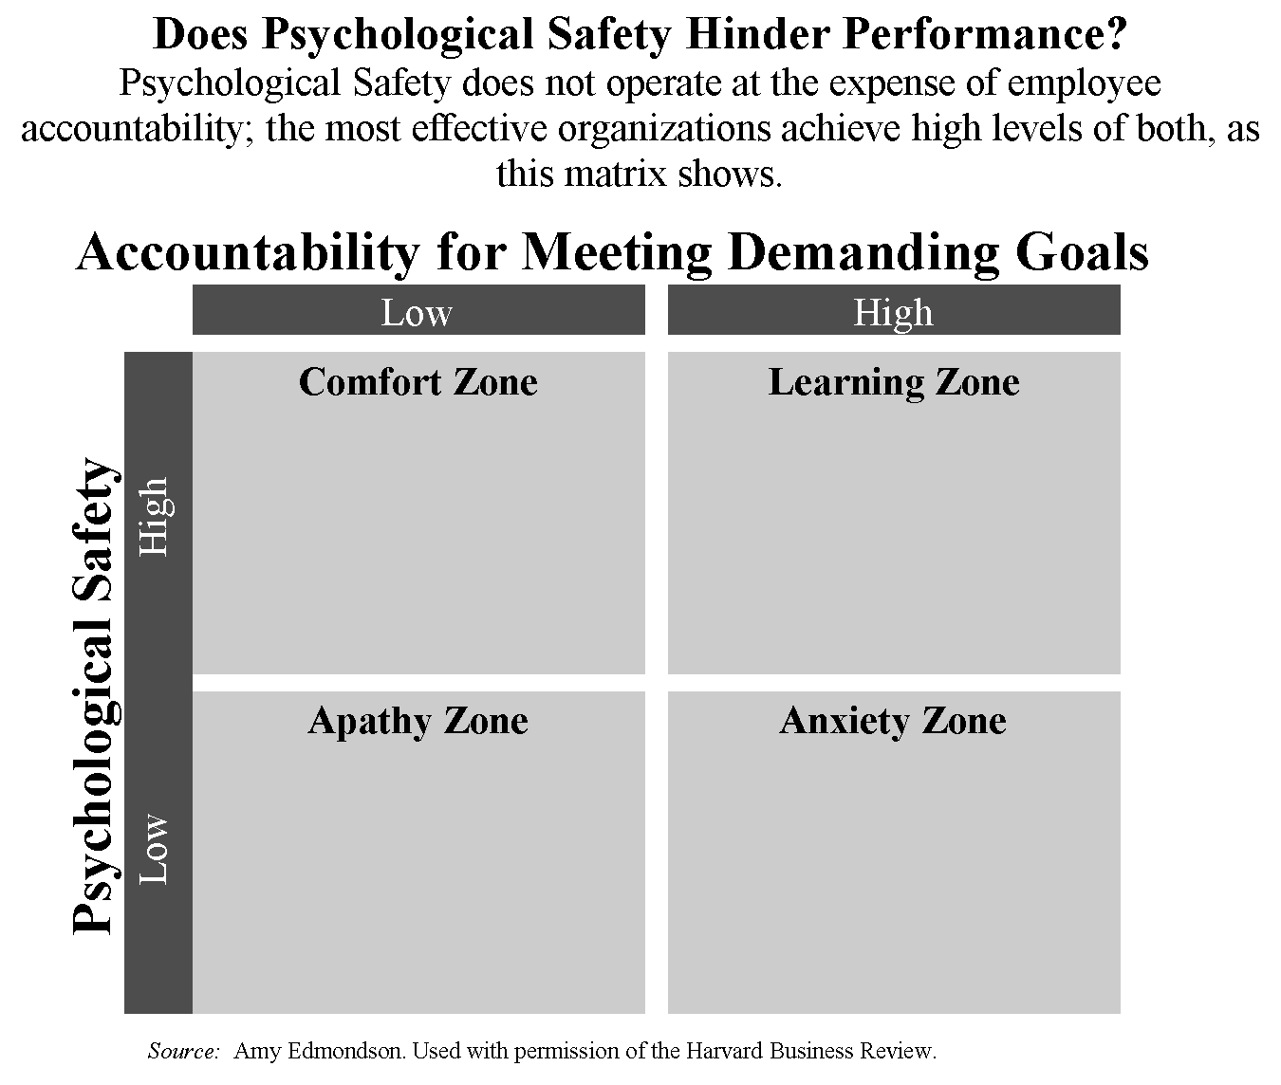

Slide 23
Value Based Leadership = Value Based Employees
Fairness
Authenticity
Credibility
Transparency
Stewardship

Slide 24
Tips for Promoting a Learning Organization
Unearth the “skeletons in the closet”
Are there past organizational traumatic experiences that are still playing a role in your organization?
Increase organizational transparency
What information are you keeping secret unnecessarily?

Slide 25
Tips for Promoting a Learning Organization (continued)
Address bullying in your organization.
Are people afraid to speak their mind?
Review whether everyone that needs to be at the “table” is there.
Do all the members of staff, clients, and key family members participate in decisions relating to their lives?

Slide 26
Tips for Promoting a Learning Organization (continued)
Review conflict management strategies and try out new ones.
Are there chronic sources of conflict that are never resolved?
Find out if you encourage an environment where dissent is welcomed.
Are there things that are simply undiscussable?

Slide 27
Tips for Promoting a Learning Organization (continued)
Evaluate staff morale
Are staff inspiring hope and change?
Evaluate whether or not there are destructive parallel processes going on.

Slide 28
What Else Can a Leader Do?
Encourage workers to talk about their feelings and acknowledge these feelings. (Reflective Supervision)
Validate and respect co-workers.
Establish support systems and promote informal socializing to reduce feelings of isolation.
Offer breaks away from the clients.
Address safety issues .
Provide adequate resources.
Create an environment that is reasonably comfortable.

Slide 29
What Else Can a Leader Do? (continued)
Monitor for signs of burnout.
Look out for your own needs and encourage employees to do the same.
Make responsibilities clear.
Tell new or prospective employees what to expect and be blunt.
Screen carefully.
Use the Enhancing Critical Thinking: A Supervisor’s Guide during case related supervision.
Consider seeking outside help.

Slide 30
Thanks for Your Participation!

